Slide 1



Slide 2

Near Vertical
Incidence Skywave
HF for useful stuff
Mike Granatt M0RYK
(with acknowledgements to David M Fiedler and
Edward J Farmer, G3PVA, G4MWO, the University of Ulster and others)

Slide 3
MF and HF are special
Tiny proportion of the radio spectrum
Can’t support high data volumes or speeds, but can refract through the ionosphere
NVIS fills the gap between line-of-sight groundwave, and DX skywave
Can support reliable comms from 0-400 miles

Slide 4
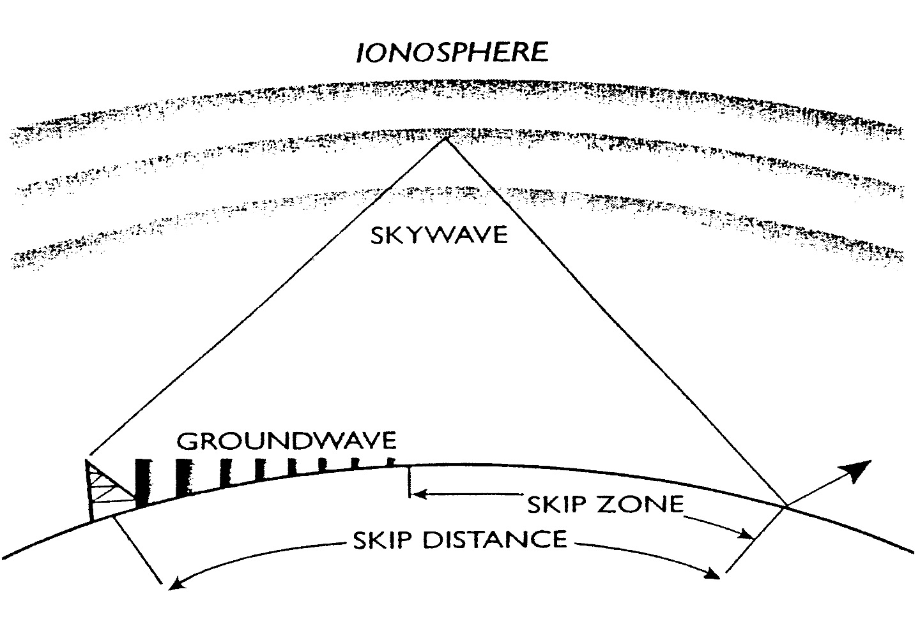

Slide 5
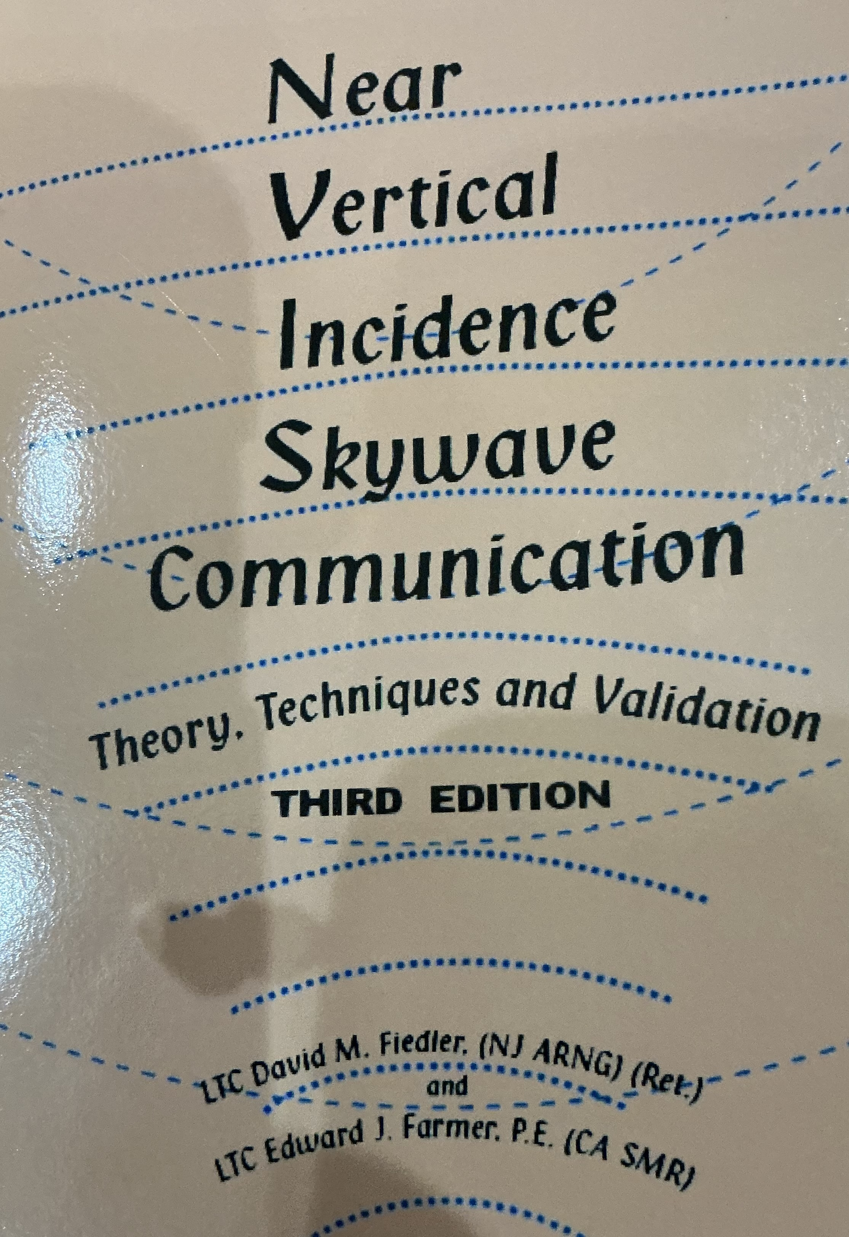
David M Fiedler and
Edward J Farmer
Lieutenant-colonels with extensive signals experience, physics and engineering graduates, and licensed radio amateurs. They campaigned for the military to recognised the tactical value of NVIS

Slide 6
“Current doctrine is wrong…”
“…there can be a skip zone if the communicator selects an antenna with too low a radiation angle, but there is no skip zone unless you, the communicator create it! …
“…We must banish forever the term ‘skip zone” and the thinking that created it.”

Slide 7
“It is …more and more obvious…
“…that HF radio will be the best, if not the only, means of radio communication when beyond line of sight ranges are required, when satellite communications have been destroyed or disrupted, and in situations such as quick recovery after a nuclear exchange, high intensity short duration operations, or anti-terrorist operations.”

Slide 9
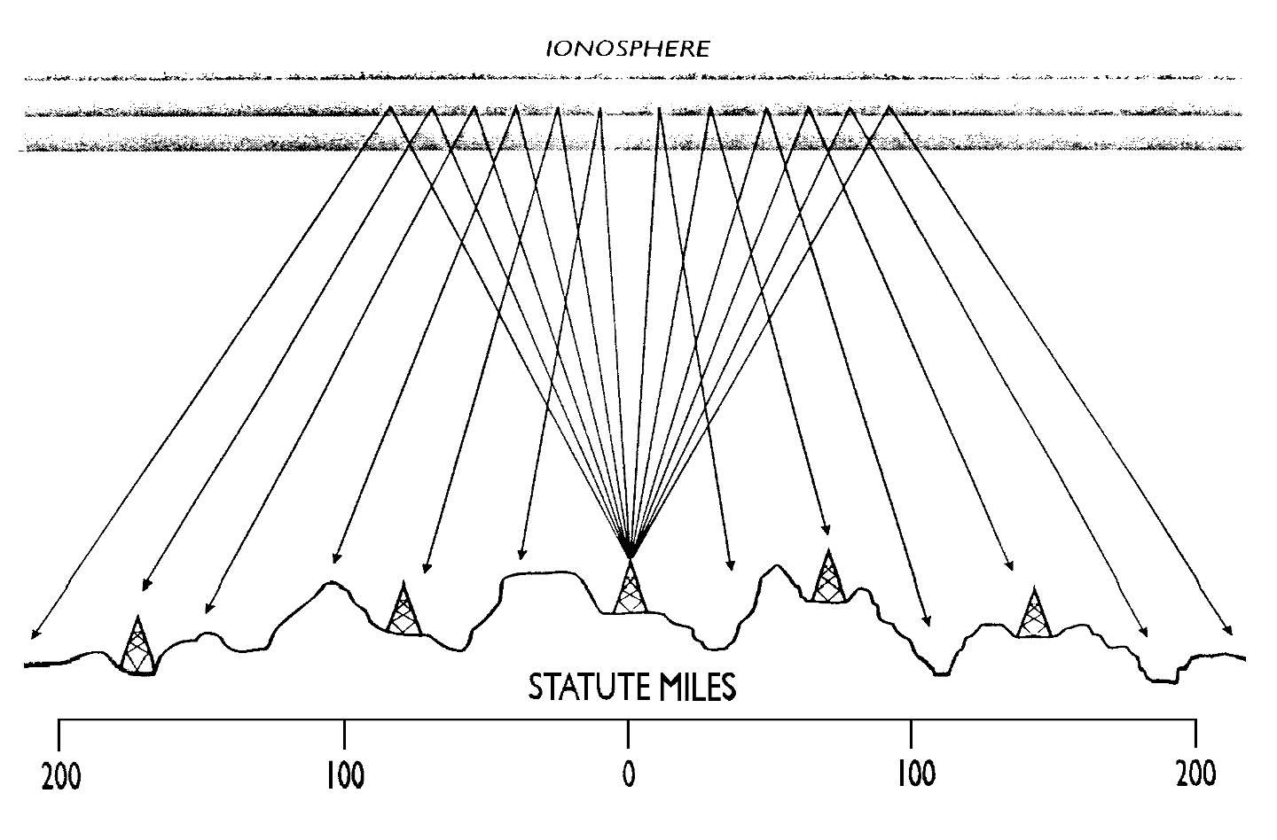

Slide 10
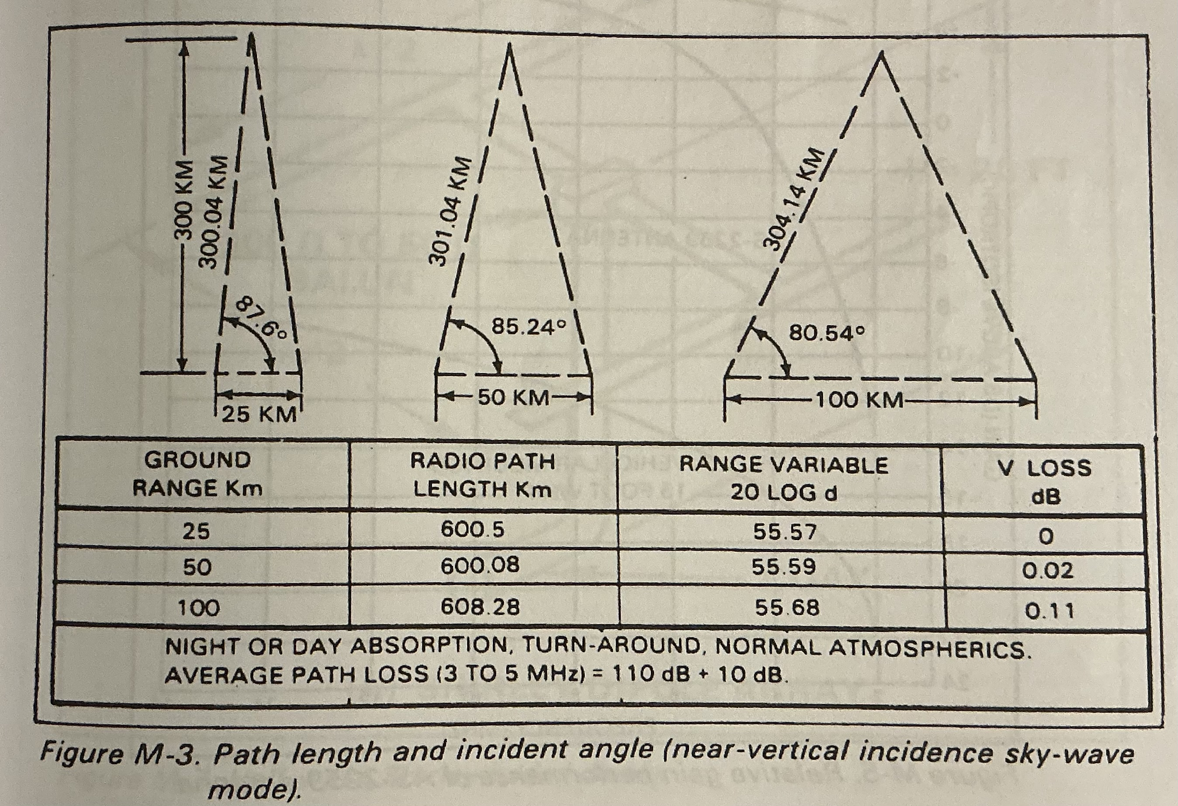
NVIS path loss is almost constant across the range

Slide 11
Tactical and electronic warfare advantages
No skip-zone
No loss of signal due to terrain. Received signal over the operational range does not vary much with ground distance
Can use very low power, with a low probability of detection
Can be used from dug-in positions. No need for high ground
Orientation of doublets or inverted antennas is not critical
Lower probability of geolocation by direction finding
Harder to jam - ground-wave jammers suffer path loss, unlike NVIS signal. Have to get close, or hike the power.

Slide 12
Aerials for NVIS

Slide 13
Key facts about NVIS
Good for reliable comms under 400 miles, on 1.5 - 10 MHz
Antennas for DX don’t work. End-feds not recommended
However….
NVIS antennas are omni-directional
Best fixed antennas are low, 2m - 7m above electrical or earth ground, and horizontal or slopers. (Taller antennas need the feed point below the ends)
Resonant wires are best
Multi-band antennas should be cut for the lowest frequency, and use a remote AMU at the end of the coax.
Mobile antennas can be loops or horizontal/inclined whips

Slide 14
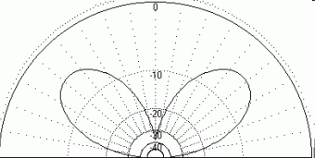
Typical DX half-wave dipole
80m aerial at 40m high, or 40m aerial at 21m.
Most power is about 42 degrees - good for DX skip

Slide 15
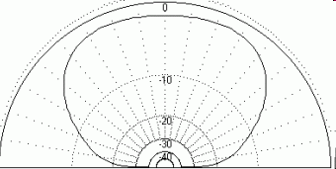
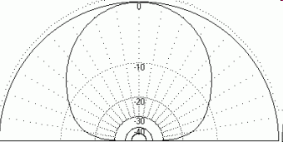
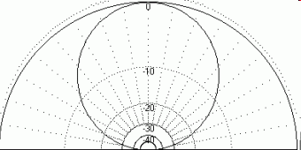
80m/40m dipoles - effect of height
Half-wave above ground
Three-eighth wave a.g.
Quarter-wave a.g.
0.77-wave a.g.

Slide 16
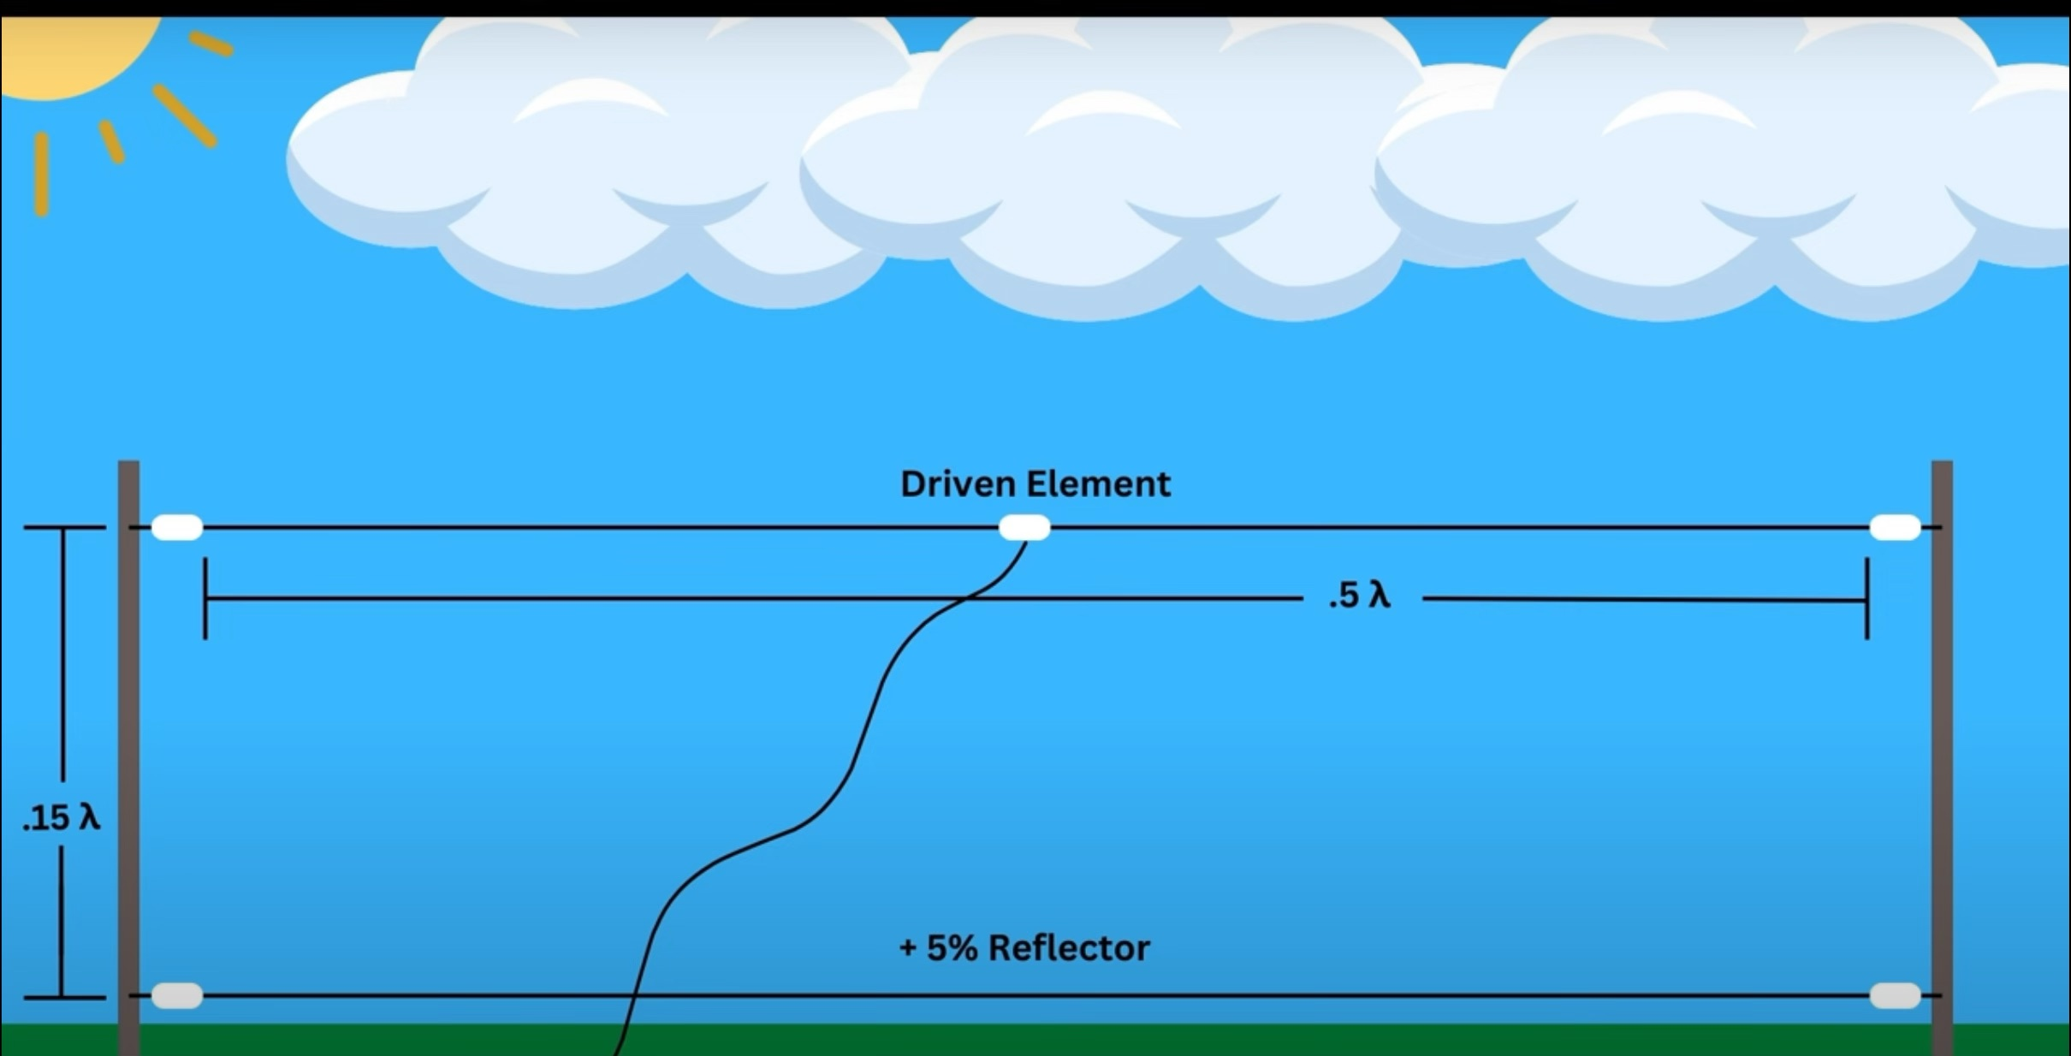

Slide 17
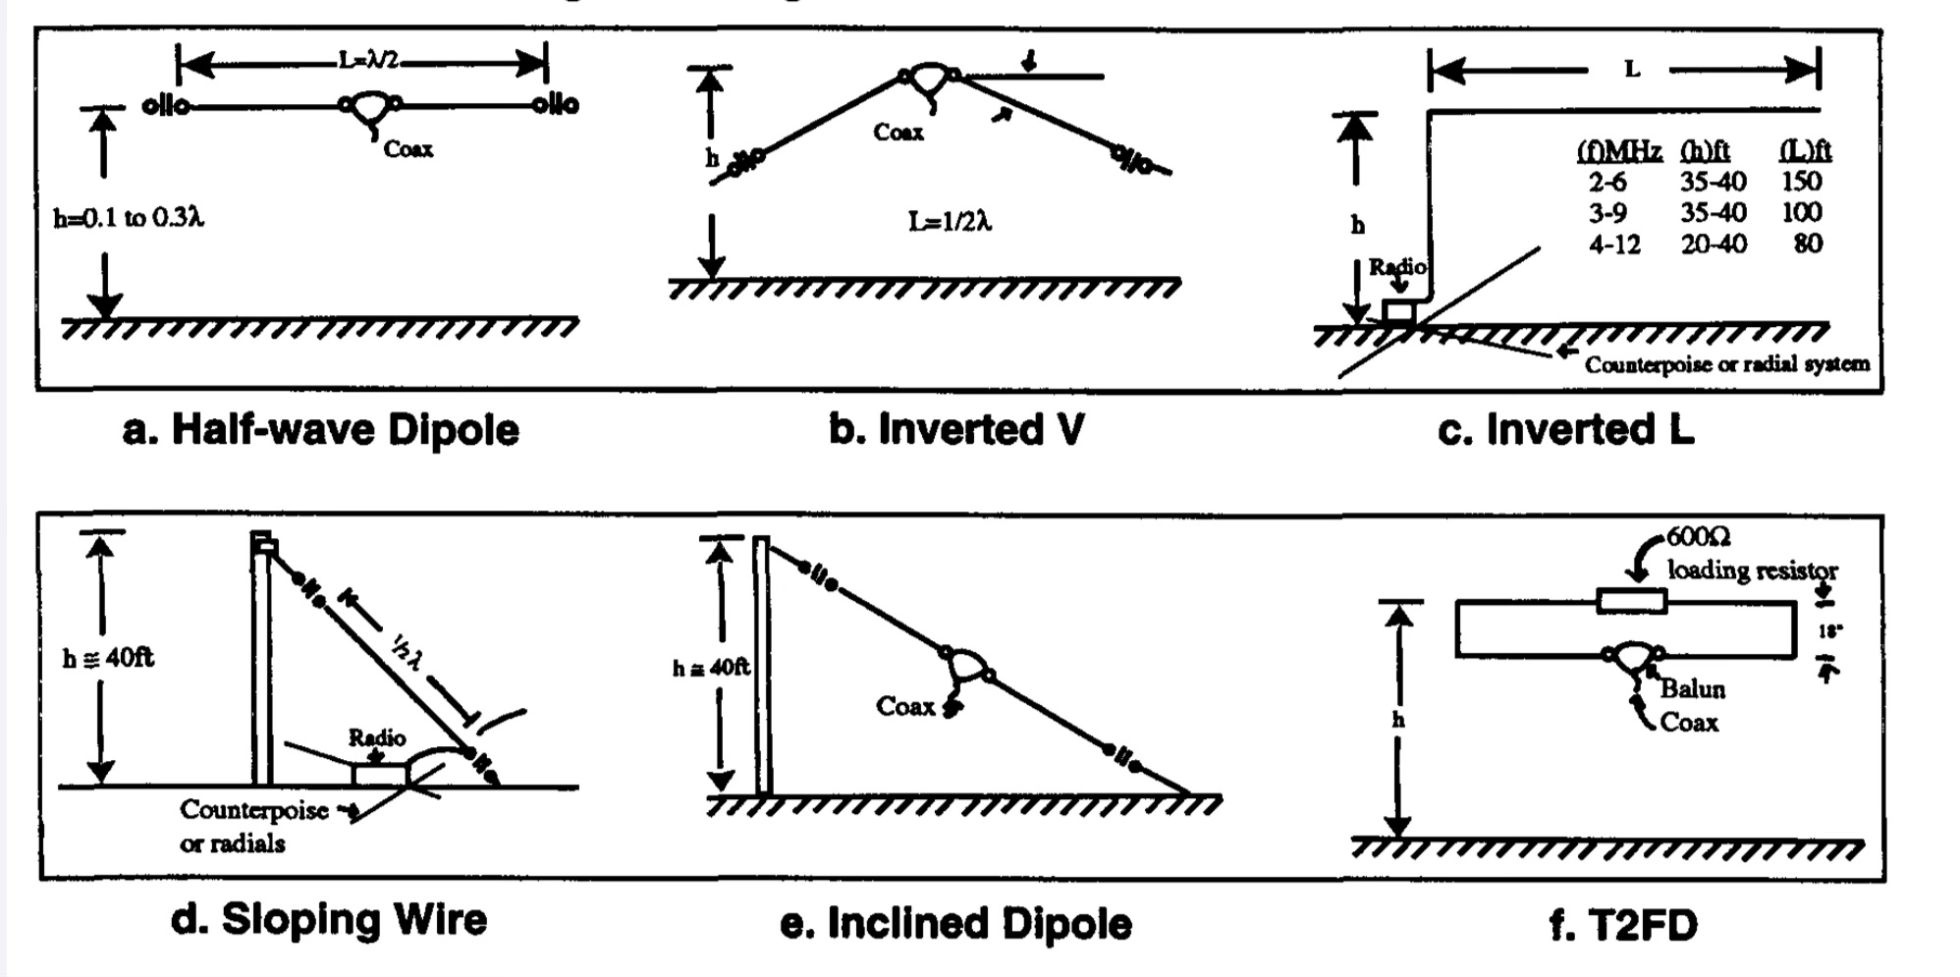

Slide 18
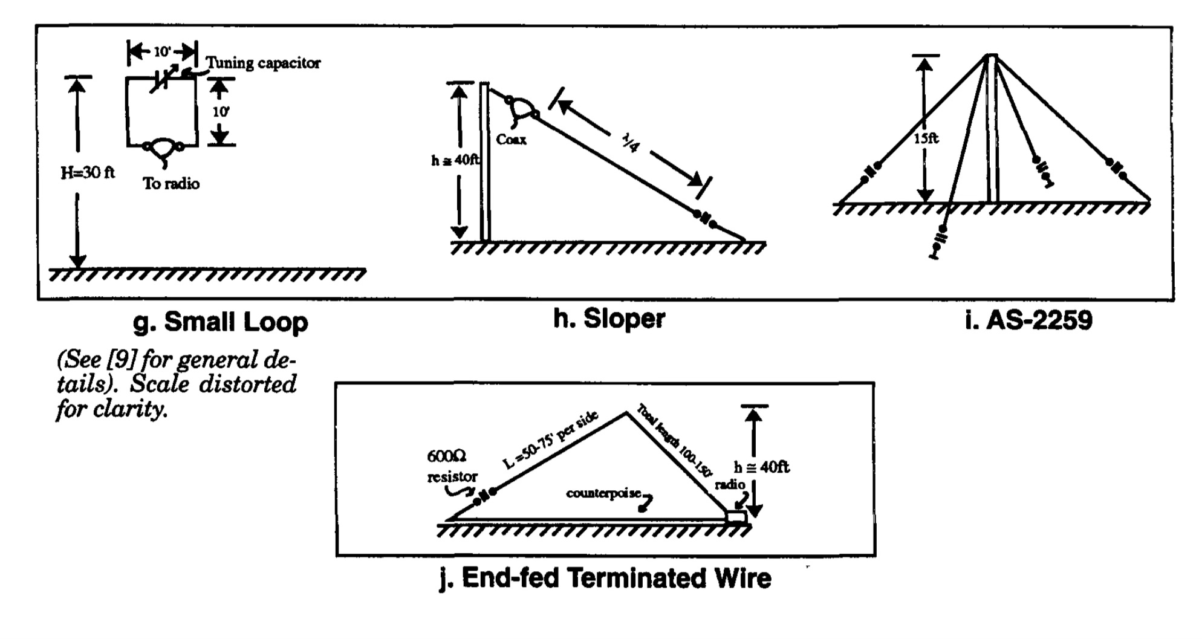

Slide 19
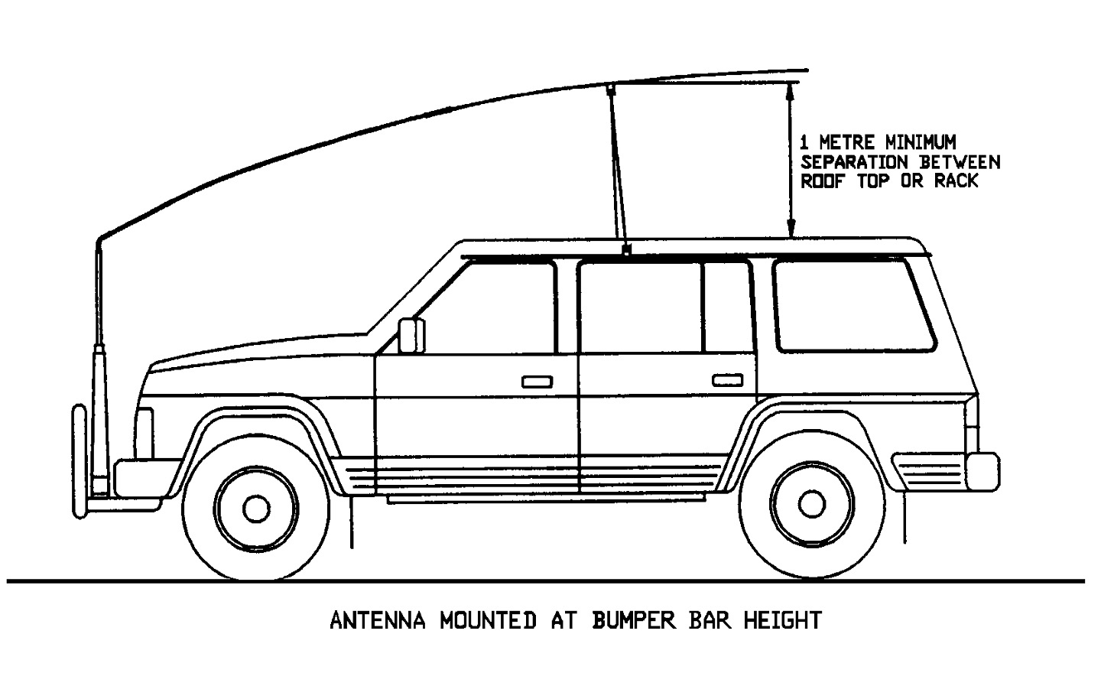

Slide 20
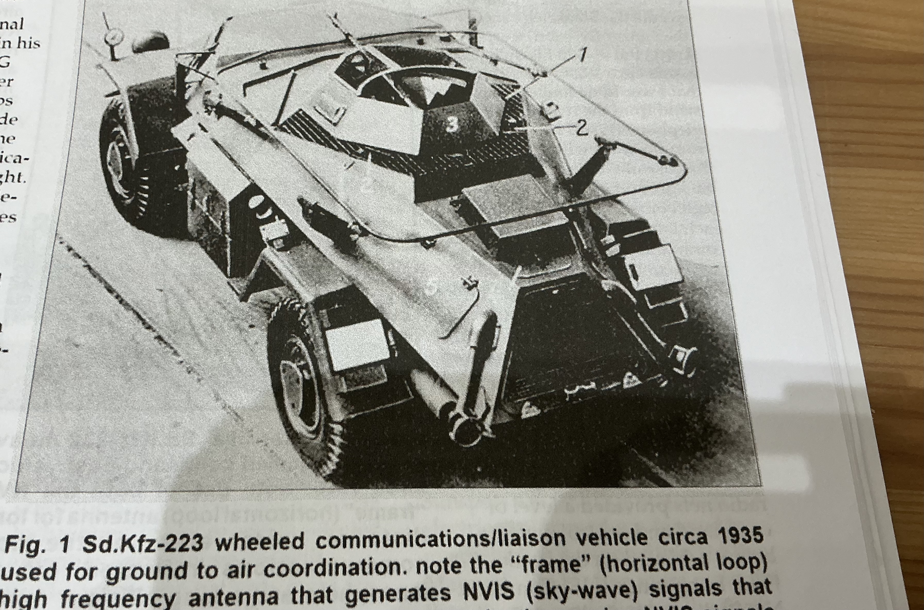
1935 German comms - NVIS loop

Slide 21
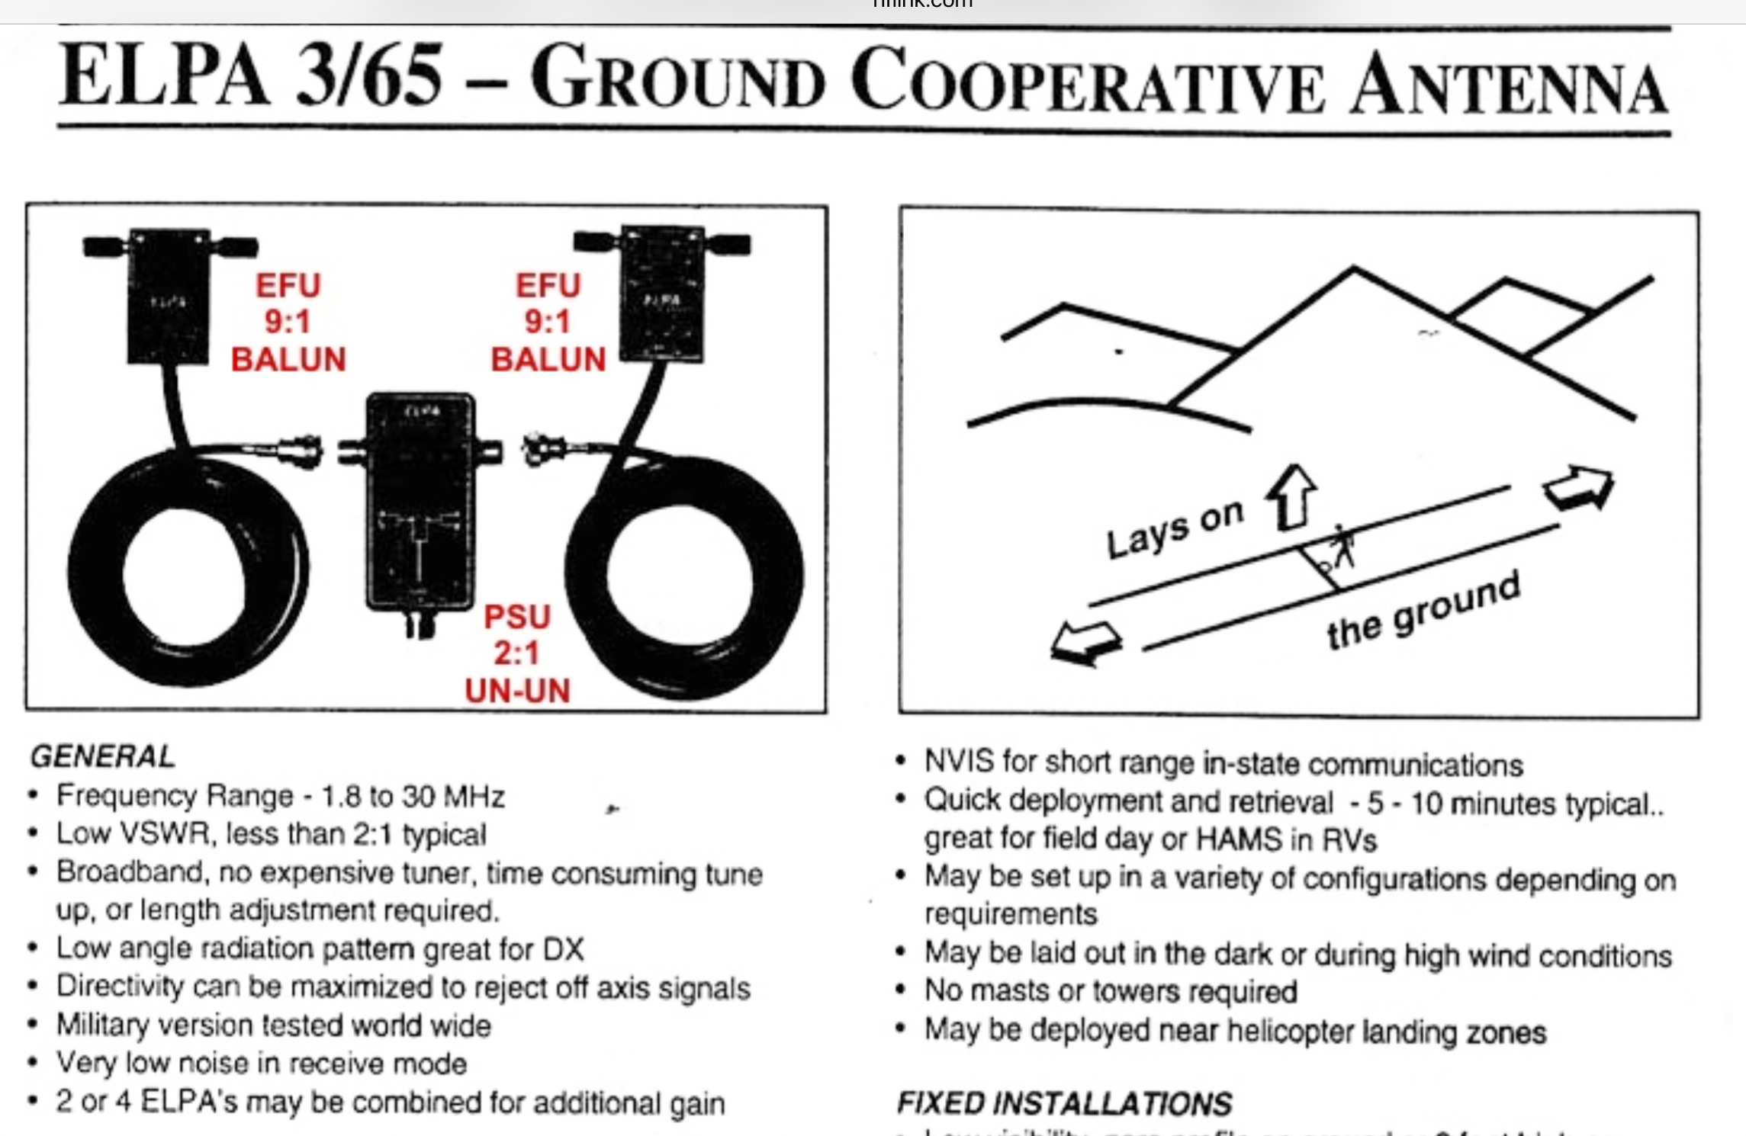

Slide 22
NVIS and D-Day
Poor radio comms were causing US forces big concerns. Planners needed excellent comms to deploy overwhelming tactical air support.
US had big issues running a single net covering a command and control ship mid-Channel. Air HQ in Uxbridge, and forward comms on the beaches.
Just before D-Day, Dr H H Beverage arrived from the US. He found vertical antennas in Uxbridge, and changed them to skywave – problem solved.
Notes:
Grave

Slide 23
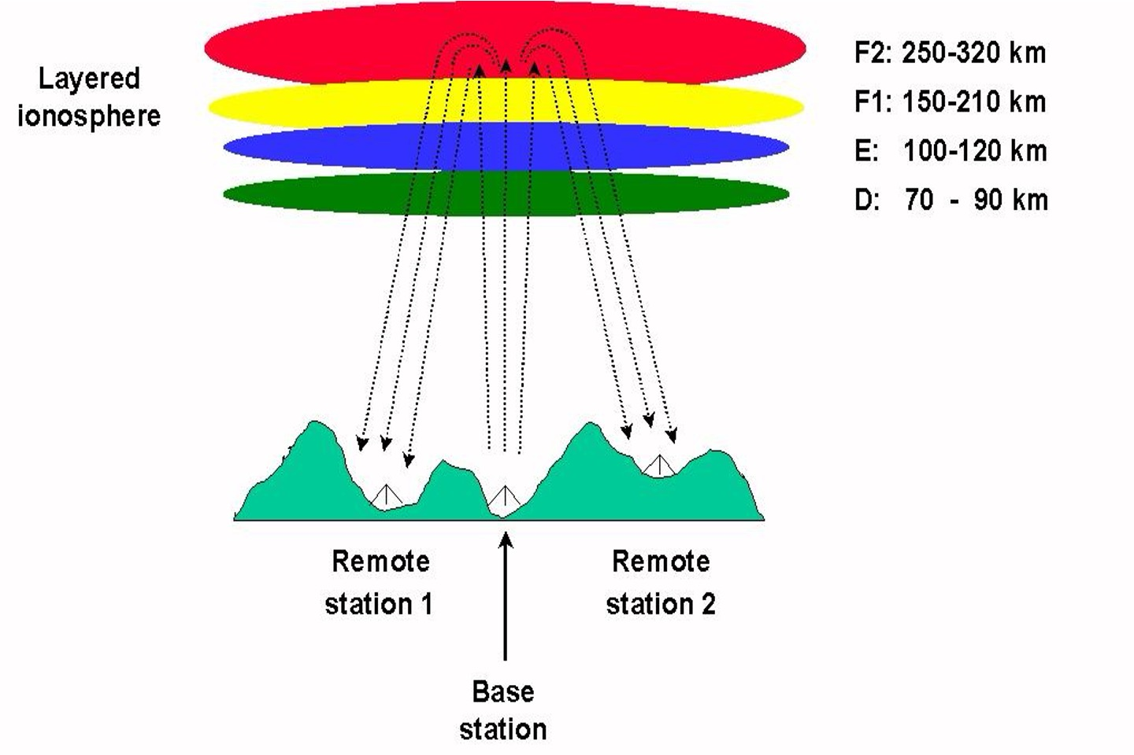
FoF2 - Critical Frequency of F layer
Highest frequency at any time that if transmitted vertically reflects to earth
Get it (and lots beside) from propquest.co.uk

Slide 24
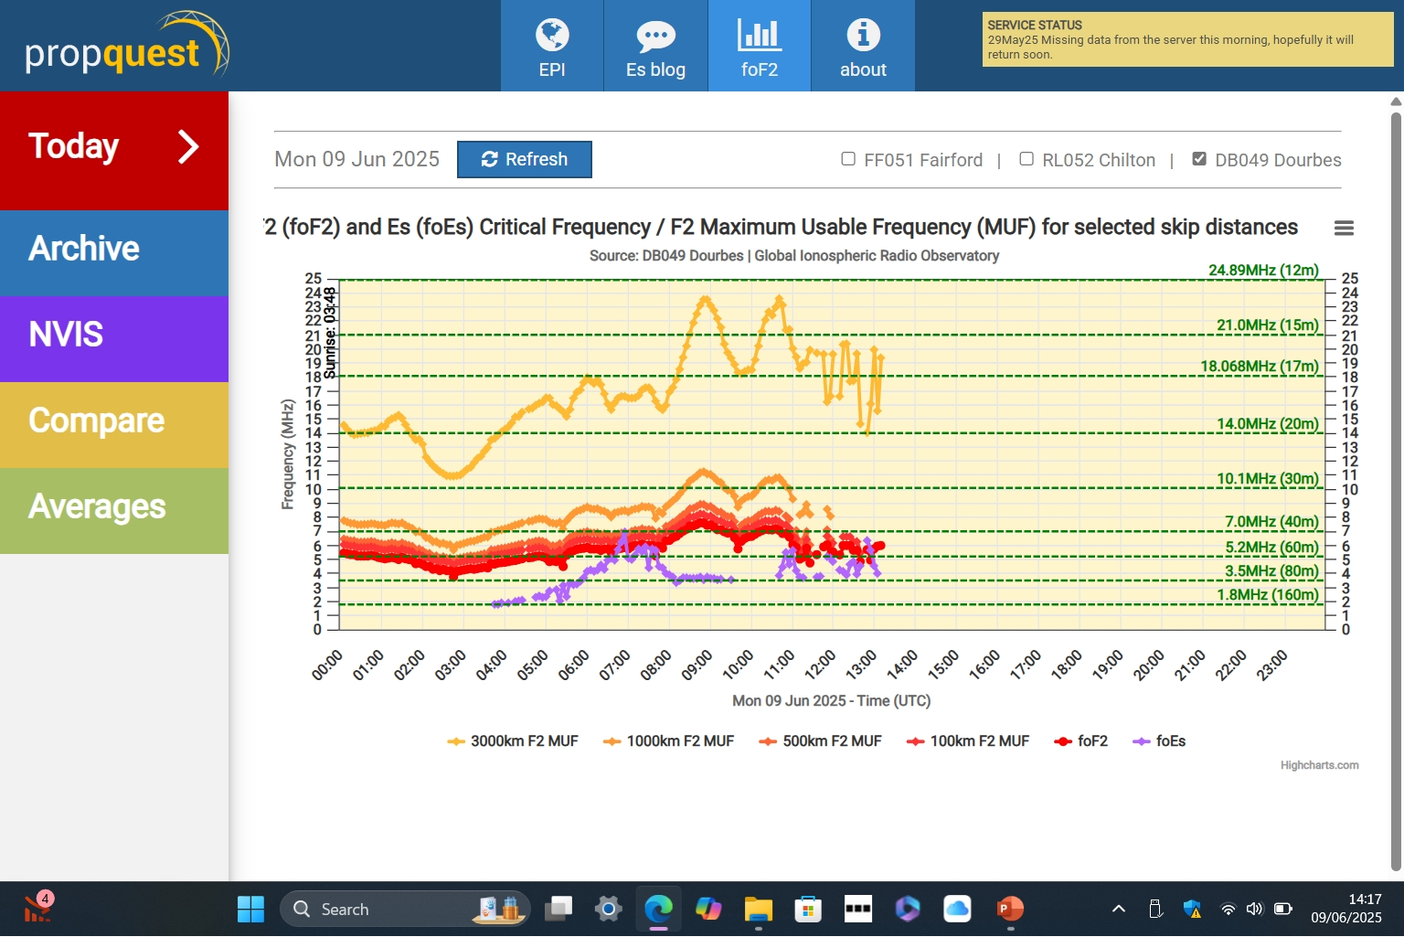

Slide 25
Tha

